Slide 1


Minor Project
AYNIYH (All You Need Is Your Hand): A C++ Based Hand Gesture Recognition System For Computer Control
Team Members:
Rittik Gan Chaudhuri (23103123)
Manas Raj (23103085)
Vansh Rai (23103159)
Faculty Mentor:
Rahul Aggarwal
Project Proposal & Implementation Workflow

Slide 2

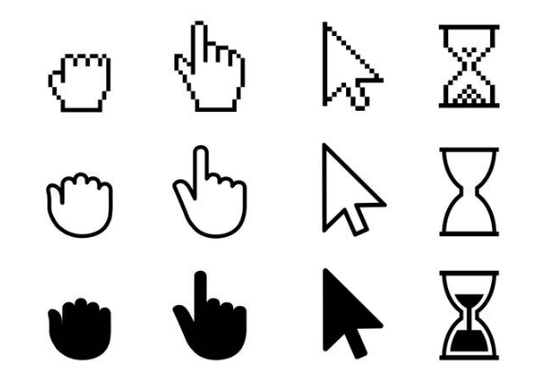
The Problem: The "Latency Gap"
Slow Response Time
Pure Python-based gesture control systems often suffer from significant latency (80-120ms), making them feel sluggish and breaking user immersion.
Interpreter Overhead
The Python interpreter adds overhead that prevents truly real-time interaction required for a professional "mouse replacement" experience.

Slide 3



Our Solution: The Hybrid Workflow
The Lab (Python)
The Factory (C++)
We use Python for its greatest strength: Rapid Prototyping & Training. It's used solely to create the AI brain.
We use C++ for its greatest strength: Speed. The final app runs natively to achieve <50ms latency.

Slide 4
System Architecture
The Pipeline
1.
Input: Webcam Feed (OpenCV)
2.
Vision: MediaPipe tracks 21 Hand Landmarks.
3.
Inference: The C++ App loads the ONNX Model.
4.
Action: Robot-CPP executes OS commands (Mouse/Keyboard).

Slide 5
Phase 1: Environment Setup
Visual Studio 2022 Community: The core IDE for C++ development.
Python 3.10+: The environment for data processing and model training.
vcpkg Manager: Used to install complex C++ libraries effortlessly.
OpenCV & Robot-CPP: Key libraries installed via vcpkg for vision and control.

Slide 6

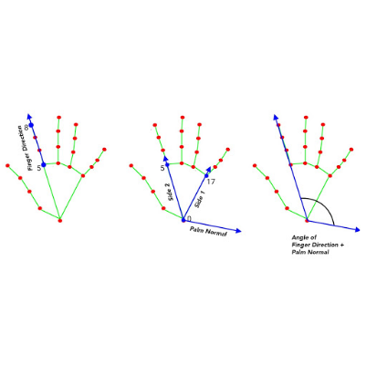
Phase 2: Data Collection
Capturing Reality
We built `collect_data.py` to capture raw hand movements.
It tracks 21 distinct landmarks on the hand. For every frame, it records 63 data points (x, y, z coordinates for each landmark).

Slide 7
Dataset Overview
We processed the raw data into `gestures.csv` with mapped labels:
Gesture Name | Mapped ID | Action
Open / Idle | 0 | No Action
Point | 1 | Mouse Move
Peace | 2 | Left Click
Thumb Up | 3 | Spacebar
Close / Fist | 4 | Backspace

Slide 8


The "Brain": 1D CNN
Input Layer
The Network
The model accepts a flat vector of 63 floating-point numbers, representing the instantaneous position of the hand.
We use a 1D Convolutional Neural Network (CNN). This architecture is highly efficient at finding patterns in sequences of spatial data.

Slide 9
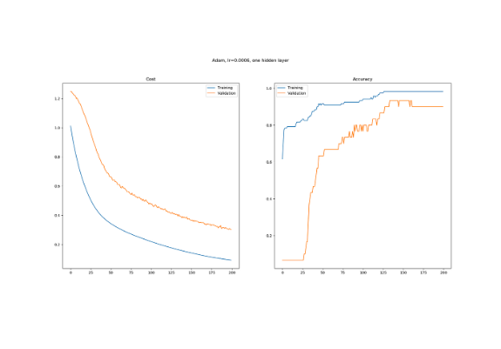
Training Results
High Accuracy
The model was trained using `train_cnn.py` with an 80/20 train-test split.
We monitored Loss and Accuracy to ensure the model generalizes well and doesn't just memorize the training data.

Slide 10
"The Bridge"
We exported the trained TensorFlow model to .ONNX (Open Neural Network Exchange) format.
This allows our high-speed C++ application to read and execute the Python-trained brain without needing Python installed.

Slide 11



Project Timeline
Phase 1 & 2
Transition
Phase 3
Environment Setup & Python Training
Exporting ONNX & Setting up C++
C++ Integration & Real-time Test

Slide 12
Thank You
Thank you for your attention.

